Slide 1
Enabling Traditional Vision on Specialized Deep Learning Hardware
Paul Brasnett
Senior Research Manager
PowerVR Vision & AI
Notes:
1

Slide 2
Overview
Introduction
Mapping traditional vision to deep learning primitives
Traditional vision to learning-based vision

Slide 3
Introduction

Slide 4
Imagination: A global technology leader
A technology powerhouse for multimedia and communications IP
Developing innovative IP
PowerVR GPU: leader in graphics & compute
PowerVR Vision & AI: dedicated IP for vision & AI
Ensigma: connectivity and broadcast communications IP
Delivering exceptional service
Enabling very fast time to market
Enabling customers to leverage IP to maximise differentiation
Driving major markets
Helping our partners to create successful solutions
Influencing new and emerging opportunities
Showcasing and proving our technology with real products
Products
More than 10bn units shipped
Over 3m per day
Around 1.2bn in past year
People
HQ in UK
>800 people world-wide
>80% of staff are engineers

Slide 5
Introduction
Traditional vision → deep learning
Significant investment in traditional vision
Expect to move over to deep learning for some or all algorithms
Choices today when designing or selecting silicon
Optimise for deep learning
Optimise for traditional vision
Increased cost to provide dedicated support for both
Programmable solutions available do not ‘solve’ the problem
Still need to make a choice about priorities

Slide 6
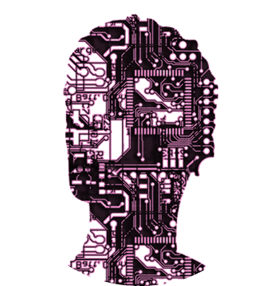
Embedded AI
Edge Processing on Modern System on Chip (SoC)

Slide 7
Modern SoC
CPU
GPU
Vision
Video
ISP
Comms

Slide 8
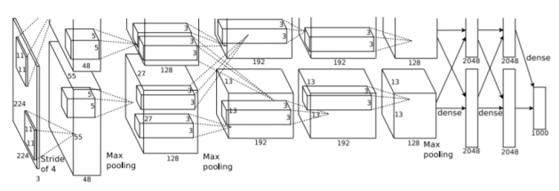
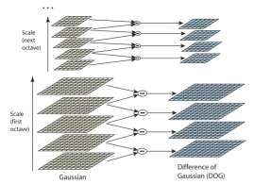
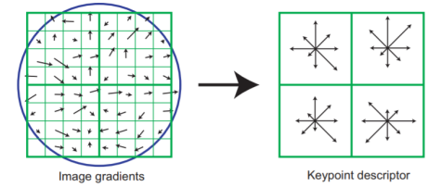
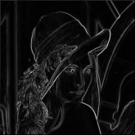
Traditional Vision v Deep Learning
Traditional Computer Vision
> 30 years investment by industry
Often good enough for specific tasks
Proven, mature and understood
Diverse set of primitive operations
Lots of algorithmic secret-sauce
Deep Learning
Huge investment over past 3-4 years
State-of-the-art for many tasks
New model development takes investment
Relatively small set of basic primitives
Although increasing

Slide 9
Modern SoC
CPU
GPU
CPU
GPU
Trad. Vision
Video
NNA
Video
ISP
Comms
ISP
Comms
Traditional Computer Vision SoC
Deep Learning SoC

Slide 10
Processors for Embedded Vision
Maximum flexibility
Programmable
Fixed function
Optimum performance, area and power
Traditional Vision
DNN

Slide 11
Processors for Embedded Vision
Maximum flexibility
Programmable
PowerVR 2NX
Fixed function
Optimum performance, area and power
Traditional Vision
DNN

Slide 12
Processors for Embedded Vision
Maximum flexibility
Programmable
Traditional Vision
Fixed function
Optimum performance, area and power
Traditional Vision
DNN

Slide 13
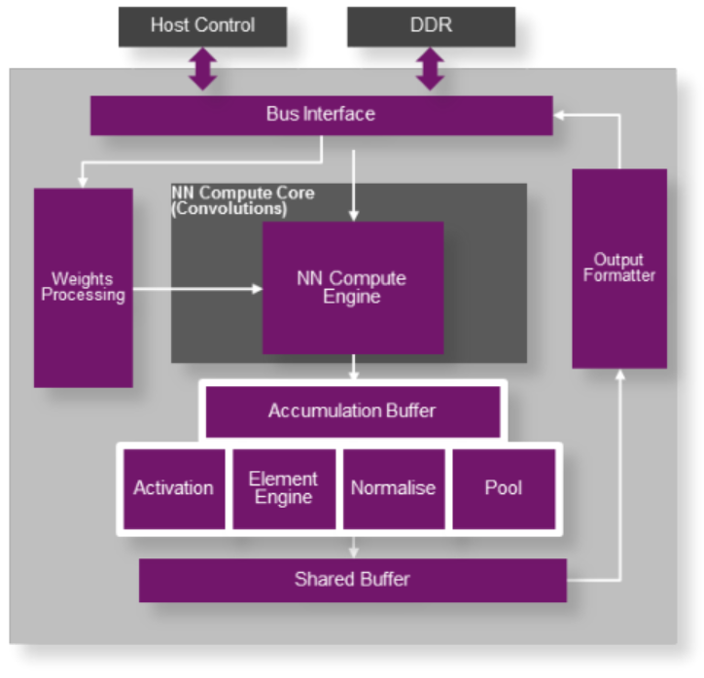
PowerVR 2NX
Deep Learning IP
Scalable neural network IP
Up to 4TOp/s
Fully flexible data types support
Efficient data exchange formats for NNA to GPU/CPU
Dedicated support for all key neural network layers

Slide 14
PowerVR 2NX
Optimised Dataflow
Image
Convolution
Activation
Pooling
Normalization
PowerVR 2NX – Single Pass
Image
Convolution
Activation
Pooling
Normalization

Slide 15
Deep Learning Primitives
DNN primitives
Convolution
Convolution transposed
Fully Connected
Activation
Pooling
Tensor Operations
Normalisation
Expressing traditional vision using DL primitives
Use TensorFlow, Caffe, etc.
Run on PowerVR 2NX processor
Supported by PowerVR 2NX

Slide 16
Support: From Frameworks to SoC
PowerVR NDK
CPU
GPU
Profiler
Tuner
NNA
Video
Adapter
ISP
Comms
Mapper

Slide 17
Expressing traditional vision using DNN primitives

Slide 18
Mapping Traditional Vision to DNN Primitives
Example 1: Binary Morphological Operator - Dilate
Input
Image
Structuring
Element
Output
Image

Slide 19
Mapping Traditional Vision to DNN Primitives
Example 1: Binary Morphological Operator - Dilate
for(int i=0;i<height;i++)
for(int j=0;j<width;j++)
{
…
}
Input
Image
Structuring
Element
Output
Image

Slide 20
Mapping Traditional Vision to DNN Primitives
Example 1: Binary Morphological Operator - Dilate
for(int i=0;i<height;i++)
for(int j=0;j<width;j++)
{
…
}
Input
Image
Structuring
Element
Output
Image
Pooling: - Max
- 3x3 window - 1x1 stride
max_pool(in,[1,3,3,1],
[1,1,1,1])

Slide 21
Mapping Traditional Vision to DNN Primitives
Example 2: 2x Bilinear Up-Scaling
Make use of convolution transpose primitives
y_{m}
y_{m+1}
y_{m+2}
y_{m+3}
f₀
f₁
Convolution with stride = 2
x_{n}
f₂
f₀
X_{n+1}
f₃
f₁
X_{n+2}
f₂
f₀
X_{n+3}
f₃
f₁
f₂
f₃

Slide 22
Mapping Traditional Vision to DNN Primitives
Example 2: 2x Bilinear Up-Scaling
Make use of convolution transpose primitives
y_{m}
y_{m+1}
y_{m+2}
y_{m+3}
Convolution transpose, scale factor = 2
f₀
y_{m}
y_{m+1}
f₁
x_{n}
f₂
f₀
X_{n+1}
f₃
f₁
X_{n}
f₀
f₁
f₂
f₃
X_{n+2}
f₂
f₀
X_{n+1}
f₀
f₁
f₂
f₃
X_{n+3}
f₃
f₁
f₂
f₃

Slide 23
Mapping Traditional Vision to DNN Primitives
Example 2: 2x Bilinear Up-Scaling
Linear upscale with scaling factor = 2
y_{m}
y_{m+1}
X_{n}
0
0.5
1
0.5
X_{n+1}
0
0.5
1
0

Slide 24
Mapping Traditional Vision to DNN Primitives
Example 2: 2x Bilinear Up-Scaling
2D linear upsample filter with scaling factor = 2
0.25
0.25
0.5
0
0.25
0.5
0.25
0.25
0.25
0.5
0
0.5
1
0.5
0.25
0.5
0.25
0.5
0.5
1
0
0
0
0
0
conv2d_transpose(input,[[0.25,0.5,0.25],[0.5,1.0,0.5],[0.25,0.5,0.25], [1,new_height,new_width,channels],[1,2,2,1])

Slide 25
Mapping Traditional Vision to DNN Primitives
Example 3: Histogram
Histogram
h bins

Slide 26
Mapping Traditional Vision to DNN Primitives
Example 3: Histogram
Histogram
Convolution
h bins
1
1
1x1x1xh filters
1
1

Slide 27
Mapping Traditional Vision to DNN Primitives
Example 3: Histogram
Histogram
Convolution
h bins
1
1
1x1x1xh filters
1
1
Activation

Slide 28
Mapping Traditional Vision to DNN Primitives
Example 3: Histogram
b₁
b₀
b₃
Histogram
b₂
Convolution
h bins
1
1
1x1x1xh filters
1
1
Activation
b₀
Pooling
b₁
b₂
b_{h}

Slide 29
Traditional vision to learning-based vision

Slide 30
Mapping Traditional Vision to DNN Primitives
Feature Descriptor: Brisk
Well-known & widely used binary image feature descriptor
Good example of traditional vision
Hand designed, based on insights and intuition
Defined 60 samples around feature point
Set of 512 ‘short-distance’ pairs defined S
$$B=\left\{b_{ij}\right\}, b_{ij}=\left\{\begin{aligned}1, I\left(p_{i}\right)>I(p_{j}) \\ 0, \text{otherwise}\end{aligned}\right.$$
Generates a 512D patch descriptor
BRISK sampling positions

Slide 31
Mapping Traditional Vision to DNN Primitives
Feature Descriptor: Brisk
Express Brisk feature pairs as (sparse) matrix
$D$ = sigmoid$\left(\left[\begin{matrix}1 & 0 & ⋯ & −1 & ⋯ & 0 \\ 0 & 1 & ⋯ & 0 & −1 & 0 \\ ⋮ & ⋮ & ⋮ & ⋮ & ⋮ & ⋮ \\ 0 & ⋯ & 1 & 0 & ⋯ & −1\end{matrix}\right]\left[\begin{aligned}{I(p}_{1}^{}) \\ {I(p}_{\begin{aligned}2 \\ ⋮\end{aligned}}) \\ {I(p}_{60})\end{aligned}\right]\right)$
Map to DNN primitives
Fully connected (matrix-vector multiply)
Activation

Slide 32
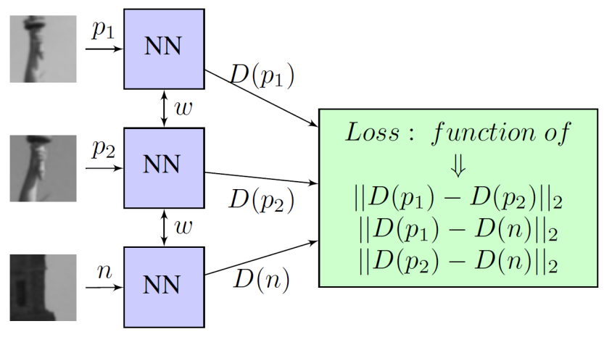
Learning a Feature Descriptor: Brisk
Learning a better descriptor
Set up a trainable weight matrix
$D$ = sigmoid$\left(\left[\begin{matrix}w_{1,1} & ⋯ & w_{1,60} \\ ⋮ & ⋱ & ⋮ \\ w_{512,1} & ⋯ & w_{512,60}\end{matrix}\right]\left[\begin{aligned}{I(p}_{1}^{}) \\ {I(p}_{\begin{aligned}2 \\ ⋮\end{aligned}}) \\ {I(p}_{60})\end{aligned}\right]\right)$,
Use triplet-loss to simultaneously
Maximise distance between different patches
Minimise distance between same patches
Use HPatches dataset

Slide 33
Feature Descriptor: Brisk
Result: HPatches (Easy)

Slide 34
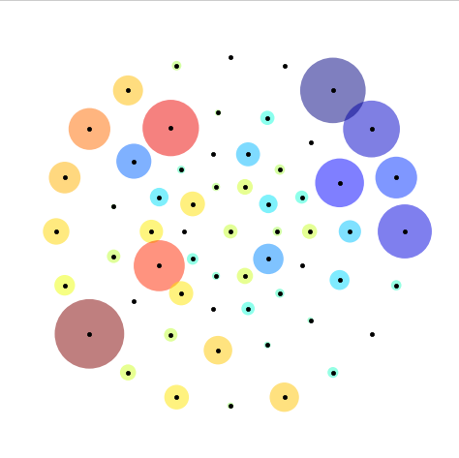
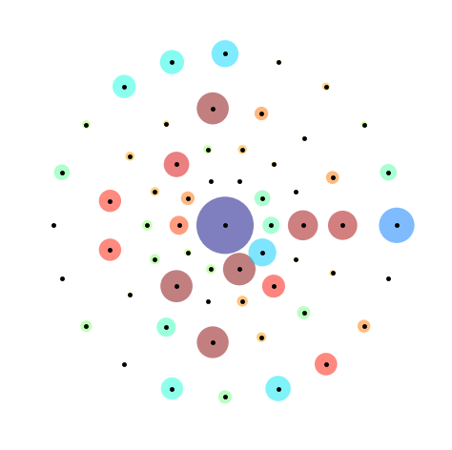
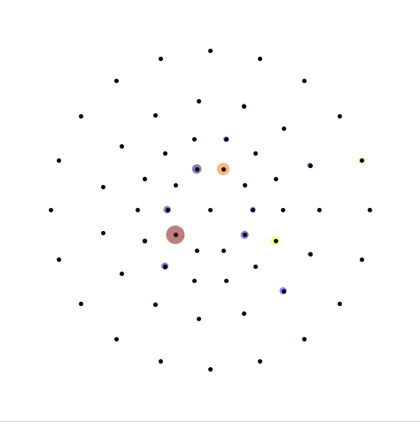
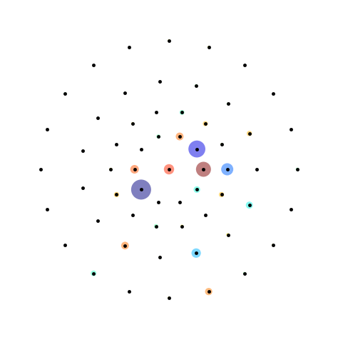
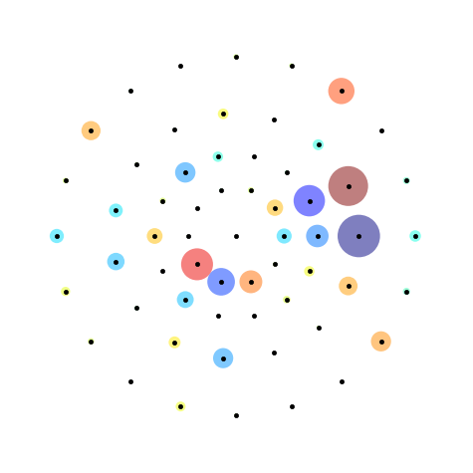
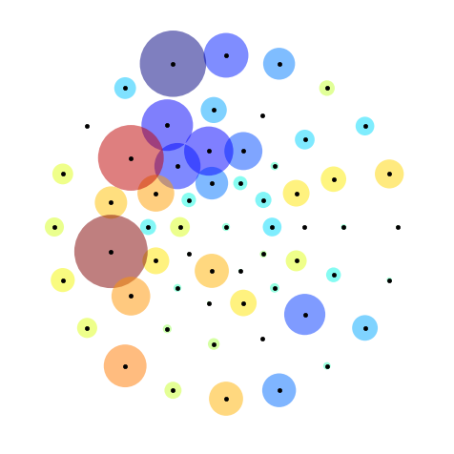
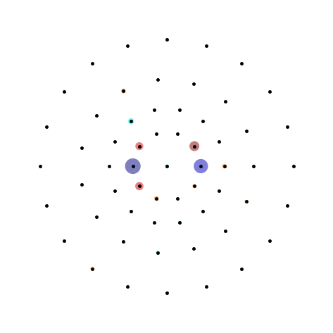
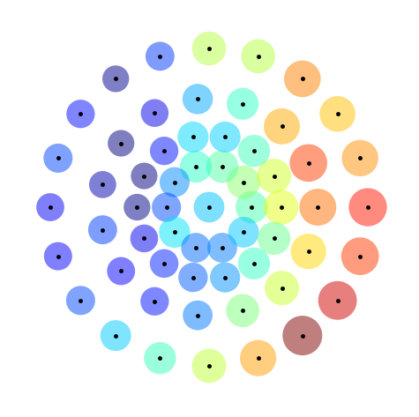
Example learnt ‘features’

Slide 35
Summary

Slide 36
Summary
Deep learning defines a set of basic primitives
PowerVR 2NX has efficient and comprehensive support for these
Traditional computer vision can be enabled in a deep learning world by exploiting these primitives
Traditional vision algorithms can then be used as a starting point for learning
Leverage existing investment
Provides a path to take incremental steps into learning

